Slide 1

T3- Data
Story telling
Project
T3_Topic{ Video Games }
By: Nareh Avagyan and Fatimah Niyas

Slide 2

Update #5
01
(Data Storyboarding && Micro Data Stories);

Slide 3
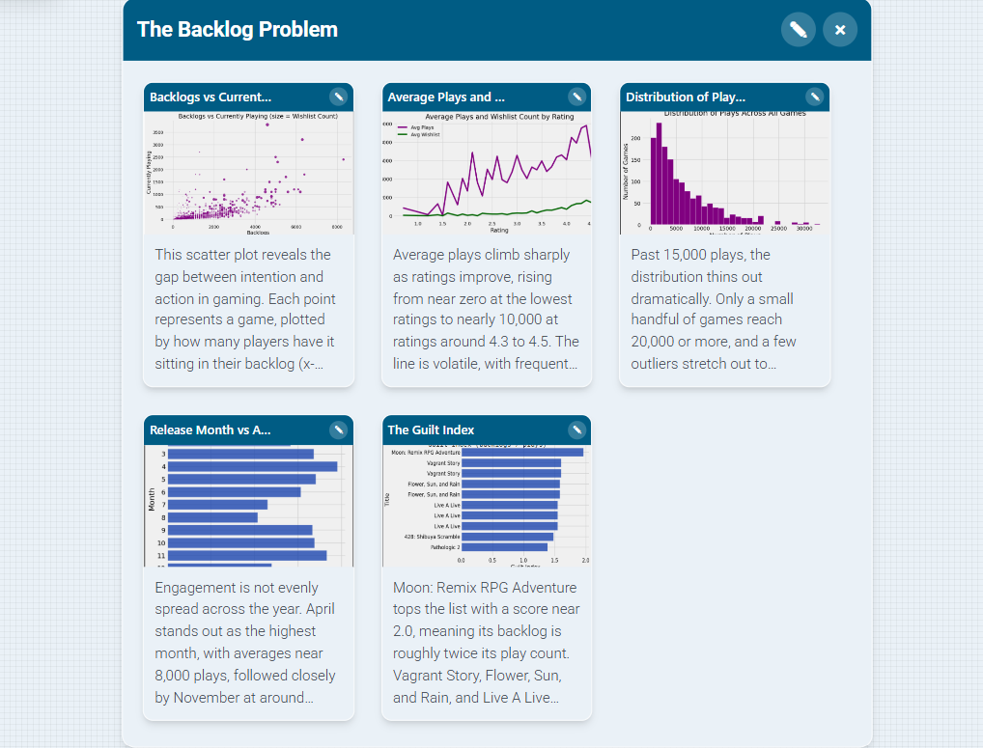
Nareh’s Data Story - The Backlog Problem
1

Slide 4
Nareh’s Data Story- Why I grouped these
2
Every gamer knows the feeling. You buy a game in a Steam sale, swear you'll play it next weekend, and three years later it's still sitting untouched while you've put another 200 hours into Minecraft. This board explores the data behind that universal experience. The gap between the games we buy and the games we actually finish.
So which games win that scarce attention? The top 10 most-played list is won over by accessible, replayable, social, or open-ended titles. Minecraft, GTA V, Breath of the Wild, Doom, Portal. These are games people return to again and again, crowding out everything else in the library.
This is where the backlog problem emerges, plotting backlogs against currently-playing counts shows a striking pattern that when games accumulate in players “to play” folder” the likelihood of people actually playing them grows a lot slower.

Slide 5
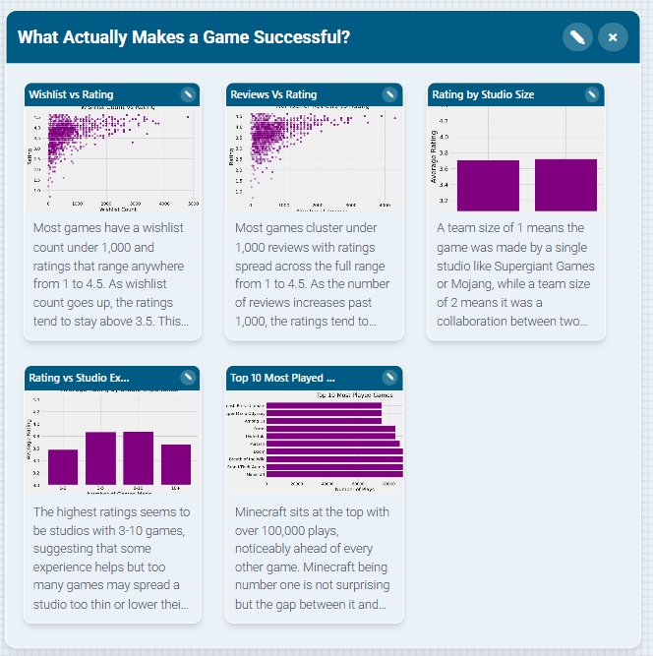
Fatimah’s Data Story - Success in Games
1

Slide 6
Fatimah’s Data Story - Success in Games
2
Gaming is something I care about so when I got to pick what to analyze I wanted to ask questions I actually wondered about myself. Like does it matter if a game is made by multiple studios? Does having more reviews mean people actually liked it or just that more people played it? These are things I think about when I am deciding what to play next/
I grouped these graphs because they all circle back to the same thing I wanted to figure out: what actually separates a game people remember from one they forget. The top 10 most played was my starting point because I recognized some of them personally like Minecraft and GTA, but others surprised me which made me even more curious what they all had in common. Then I worked backwards asking do people wishlist them before they blow up, do reviews reflect quality, does the team matter. It is not a perfect answer but the data gives you enough to start making some sense of it.

Slide 7

Update #4
01
(Weekly Mini Updates);

Slide 8
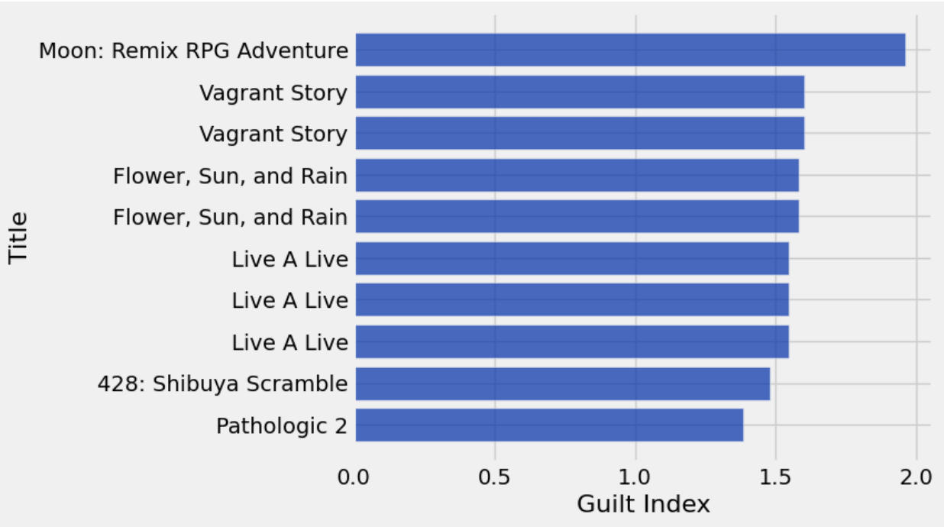
Nareh’s Mini Update: Guilt Index (Backlogs / Plays)
1
Guilt Index (backlogs / plays)
Tell on next slide >>
Show:
The guilt index measures how many people add a game to their backlog compared to how many people actually played it. The top guilty games are Moon: Remix RPG Adventure, Vagrant Story, Live A Live, and Pathologic 2. These all have backlogs ranging from roughly 1.4x to nearly 2x their play counts, meaning more people are sitting on them than actively playing them.

Slide 9
Nareh’s Mini Update: Guilt index cont.
2
Tell:
This finding adds a new layer to the overhyped vs hidden gems question. Originally,we framed hidden gems as games with few plays but high ratings, as basically games flying under the radar, The guilt index actually poses a 3rd category we didn’t consider yet: games that aren’t unknown at all but are sitting in thousands of backlogs unplayed. Looking at the names on this list, they’re nearly all critically respected RPGs and cult classics with reputations for being long, complex or emotionally heavy. Players know that these games are good. They want to play them, but the time and mental commitment required keeps them forgotten in the backlog indefinitely. For indie studios, this reframes what a “hidden gem” can mean. The challenge isn’t always getting players to discover the game, sometimes it’s getting them to actually start it. A game that is frequently backlogged is succeeding in attracting interest but losing the battle for attention against shorter, easier titles like Wordle or Agar.io , designing with accessibility and a strong early hook in mind could be the difference between a game players love and one they only intend to love.

Slide 10
Nareh’s Mini Update: New posed questions
3
Do longer games ( more story content, more time to complete) end up in more backlogs than shorter ones?
Is there a relationship between guilt and how old a game is? Older games may suggest a “I’ll get to it eventually” mentality that never actually happens, while newer ones might still have a chance of being played.
Do certain studios produce more guilty games than others? If certain studios dominate the guilt index, it confirms the “prestige but demanding” pattern and gives indie studios a clear archetype to study or avoid

Slide 11
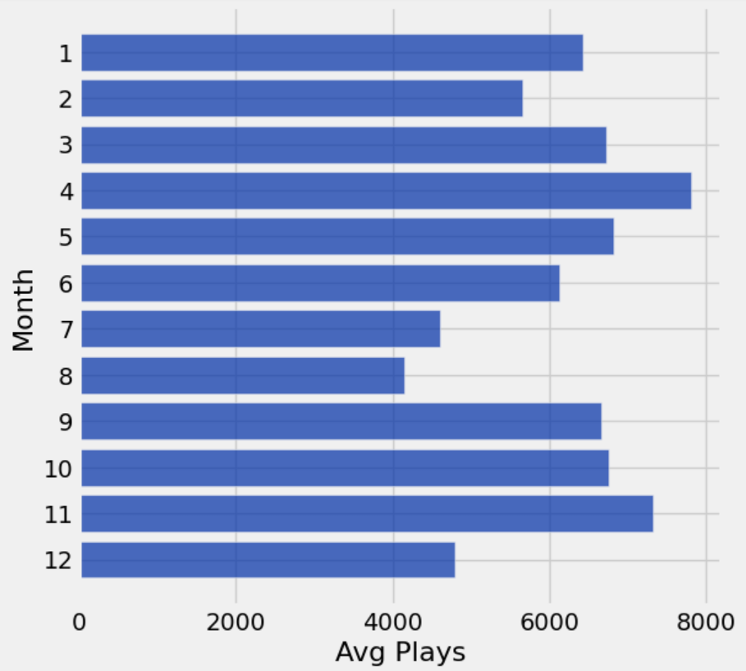
Nareh’s Mini Update: Release Month vs Average Plays
4
Show: Average plays peak in April at around 7,800, with November close behind at 7,300. The lowest months are August (4,150) and July (4,600). Ratings follow a similar but flatter pattern, with May and March on top and August at the bottom. By season, Spring is the leading season.
Tell: April is the best time to release a game. The Holiday window helps, but spring releases do better with popularity, and August is the month to avoid. The summer slump likely reflects players spending less time gaming when school is out and the weather is good. For indie studios, planning a spring release could mean catching players when they’re most engaged rather than fighting for attention in the holiday season.
Release Month vs. Average Plays

Slide 12
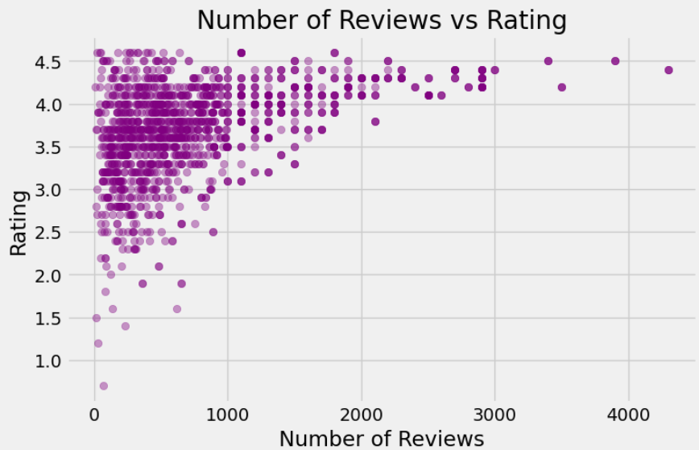
Fatimah’s Mini Update
1
Show: Most games cluster under 1,000 reviews with ratings spread across the full range from 1 to 4.5. As the number of reviews increases past 1,000, the ratings tend to stay above 3.5. There are very few games with over 2,000 reviews and they all sit at relatively high ratings.
Tell: This helps answer question 1 about what makes a game highly rated. Games with more reviews tend to be better rated, which suggests that highly rated games generate more discussion and engagement. It also makes sense that low rated games don't get as many reviews since people are less motivated to talk about a game they didn't enjoy.

Slide 13
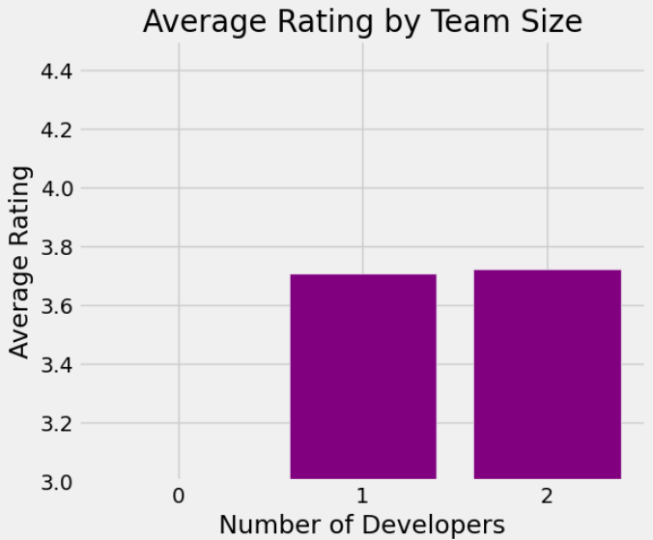
Fatimah’s Mini Update
2
Show: Games made by 1 developer average around 3.7 and games made by 2 developers average slightly above that. The difference between the two is very small but visible.
Tell: This addresses question 1 about whether team size affects rating. Based on this data, team size does not seem to make too much of a difference since solo and two developer teams produce almost identical average ratings. This suggests that the quality of a game comes down to other factors beyond just how many teams made it.

Slide 14
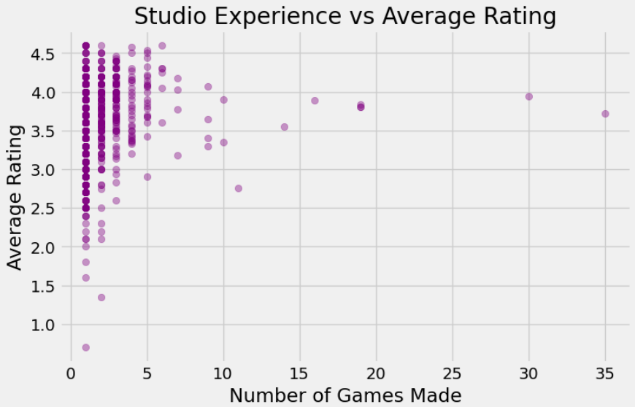
Fatimah’s Mini Update
3
Show: Most studios have made fewer than 5 games and their average ratings range widely from below 1 to above 4.5. As studios make more games the ratings tend to stabilize around 3.5 to 4.0. The studio with the most games at around 35 sits at roughly 3.7.
Tell: This addresses question 4 about which development teams consistently make the best games. Newer studios with only a few games show the most variation, meaning one bad or good game can completely define their average. More experienced studios with many games tend to cluster in a more consistent rating range, suggesting that experience leads to more reliable quality even if not necessarily higher ratings.

Slide 15
Progress Slide
Accomplished: Created new data insight plots exploring what makes a game highly rated, which studios are experienced, backlogs vs plays, and Release time vs. plays. Analyzed relationships between number of reviews and ratings, average rating by team size, and studio experience vs average rating.
Plan for next week: Begin connecting with all the insights
Obstacles: Some columns like Team were stored as lists which made it difficult to group and analyze, limiting some of the visualizations originally planned
Resources: Python, pandas, datascience library, matplotlib
Contributions: Fatimah; 3 data insights focusing on specific curious questions
Nareh; 2 data insights, 3 new posed curious questions

Slide 16

Update #3
01
(Weekly Mini Updates);

Slide 17
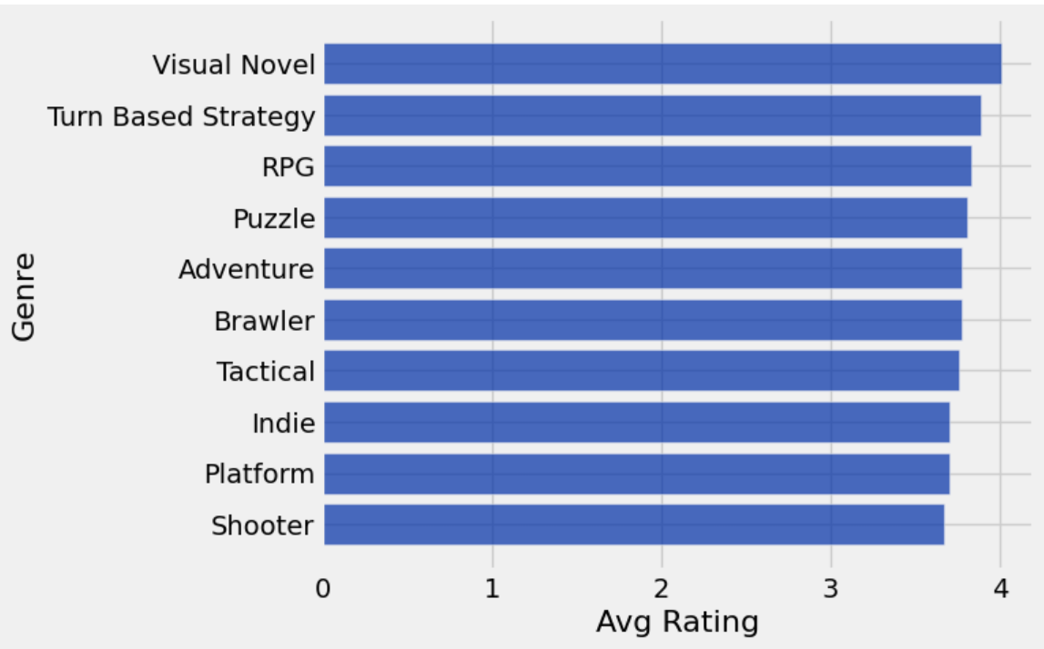
Nareh’s Mini Update - Genre by Average Rating
1
Show: Visual Novels have the highest average rating at around 4.0, followed by Turn Based Strategy and RPG. Shooters sit at the bottom of the top 10 with the lowest average rating.
Tell: This is interesting for developers because it suggests that story driven and strategy heavy genres tend to be rated higher by players. Shooters at the bottom doesn't mean they are bad, but it could just mean that it’s very oversaturated which will make it harder to stand out. From this insight, we can see that for indie game studios it could be a smart move to lean into genres like visual novels or turn based strategy games because not only are they cheaper to produce but they are also favored more highly by players.

Slide 18
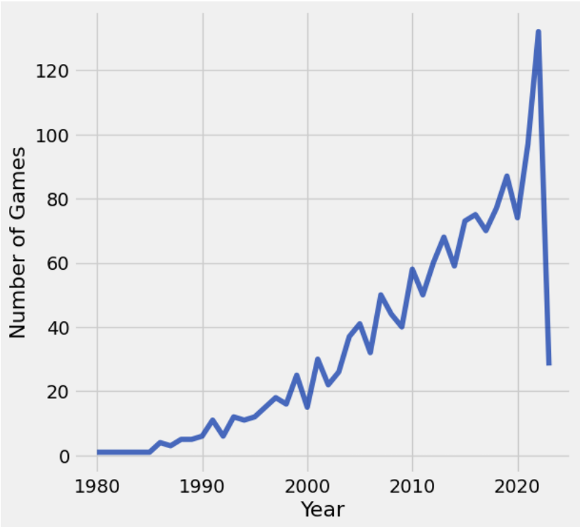
Nareh’s Mini Update - Games Released by Year
2
Show: The number of games released per year stayed relatively low from 1980 to the early 2000s, then began climbing steadily. There is a massive spike around 2020-2022, peaking at over 120 games in the dataset. After that, the count drops sharply.
Tell: The peak around 2020-2022 likely reflects both the growth of indie game development and the pandemic, when more people had time to create and play games. The sharp drop after 2022 is probably because the dataset only captures games up to a certain point, not because fewer games are actually being made.

Slide 19
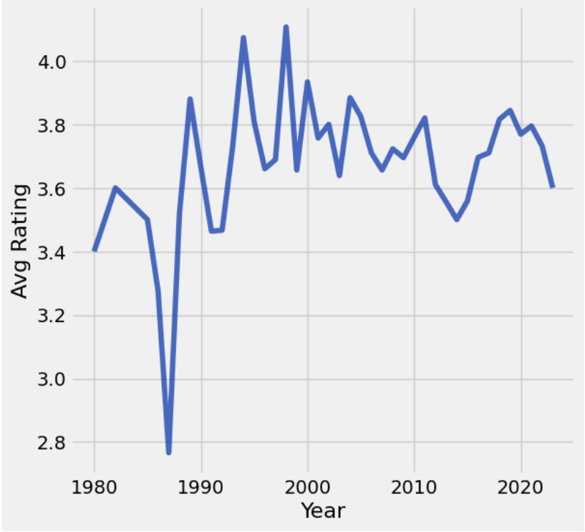
Nareh’s Mini Update - Average Rating Over Time
3
Show: Average ratings were volatile in the early years with big swings between 2.8 and 4.2. From around 2000 and on, ratings stabilize and hover in the range of 3.4 and 3.8.
Tell: The wild swings in the early years are likely because very few games were in the dataset for those years, so one good or bad game could shift the average dramatically. As more games enter the market, the average smooths out. It is worth noting that ratings have not really gone up over time despite advances in technology, suggesting that player expectations rise alongside the quality of games being made.

Slide 20
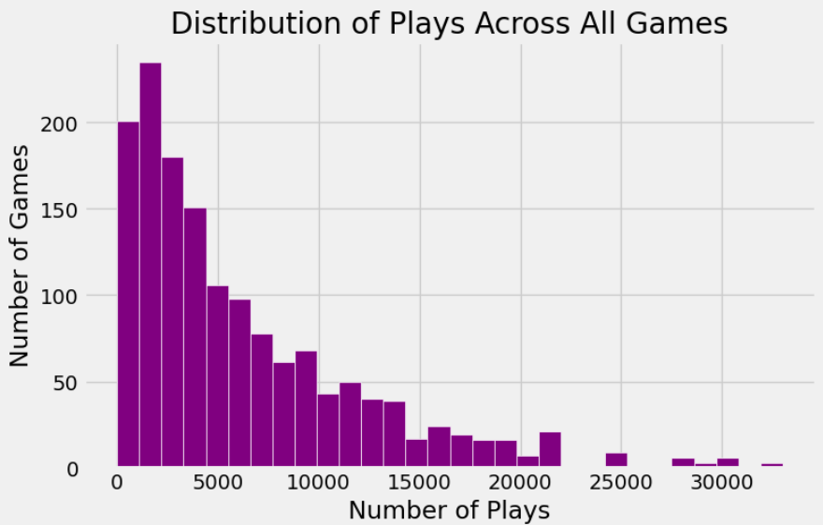
Fatimah’s Mini Update
1
Show: The distribution is heavily skewed to the right. The majority of games have under 5,000 plays, with the tallest bar sitting around 1,000 to 2,000 plays. Very few games make it past 20,000 plays and only a handful reach 30,000 or more.
Tell: This shows that having a lot of plays is actually pretty rare in the gaming world. Most games in this dataset never break 5,000 plays, which puts games like Minecraft with 100,000+ plays in a completely different league. For indie studios this is actually useful to know since breaking even a modest play count puts you ahead of the majority of games out there.

Slide 21
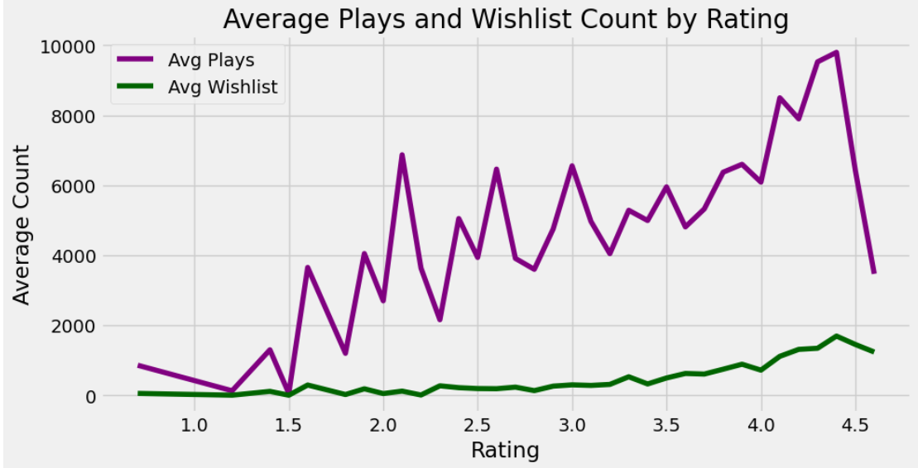
Fatimah’s Mini Update
2
Show: Both average plays and average wishlist count generally trend upward as rating increases. Average plays stay much higher than wishlist counts across all ratings. Both lines drop sharply at the very end around 4.5 to 5.0.
Tell: This directly addresses the question of which comes first - plays or wishlist. Since both go up together with rating, it suggests that higher rated games attract both more players and more wishlist adds. The drop at the very top ratings is probably because very few games have a perfect or near perfect rating so the averages get unstable there.

Slide 22
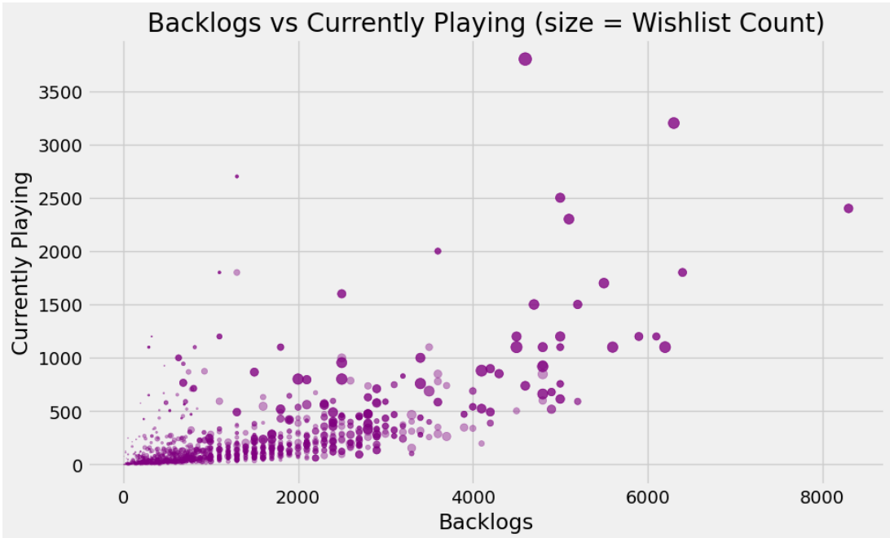
Fatimah’s Mini Update
2
Show: Most games cluster near the bottom left with low backlogs and low currently playing counts. As backlogs increase, the currently playing count also tends to go up. The bigger dots, which represent higher wishlist counts, appear more often among games with higher backlogs and playing numbers. There are a few outliers sitting very high on the currently playing axis with relatively low backlogs.
Tell: This graph shows that games with big backlogs tend to also have a lot of people actively playing them, which makes sense since popular games attract both. The bigger dot sizes scattered throughout the higher ranges suggest that wishlisted games also end up in more backlogs, meaning people add them to their list but don't always get around to them right away. Those outliers with super high currently playing counts are interesting since they suggest some games pull people in immediately rather than sitting in a backlog.

Slide 23
Progress Slide
Accomplished: Created three new data insight plots exploring genre trends and the gaming landscape over time. Analyzed which genres receive the highest average ratings, how the number of game releases has changed from 1980 to present, and whether average ratings have improved over time (Nareh). Created 3 data insight plots. Explored different variables including Backlogs, Playing, Ratings, etc. (Fatimah)
Plan for next week: Dive deeper into the overhyped vs hidden gems question by identifying specific games.
Obstacles: Interpreting the graphs and drawing clear conclusions from the data proved to be more challenging than expected, as some visualizations raised more questions than they answered.
Resources: Python, pandas, datascience library, Story Studio
Contributions: Nareh; +3 data insights Fatimah; +3 data insights

Slide 24

Update #2
01
(Weekly Mini Updates);

Slide 25
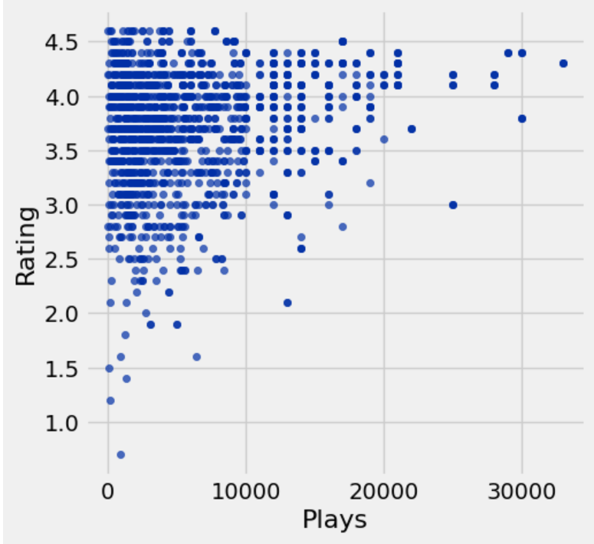
Nareh’s Mini Updates
1
Show: Most games in the dataset cluster under 10,000 plays have ratings between 2.5 and 4.5. Games with the highest play counts (20,000-33,000) tend to have ratings above 3.5, while the lowest-rated games tend to not break past a few thousand plays.
Tell: This graph suggests that highly played games generally earn their popularity with decent ratings. However, there are some interesting outliers. A few games with 15,000+ plays sit below a 3.0 rating, meaning they attracted a lot of attention but disappointed players. These could be considered "overhyped." On the flip side, many games with very few plays sit above 4.0, suggesting there are plenty of hidden gems that haven't found a wide audience yet.

Slide 26
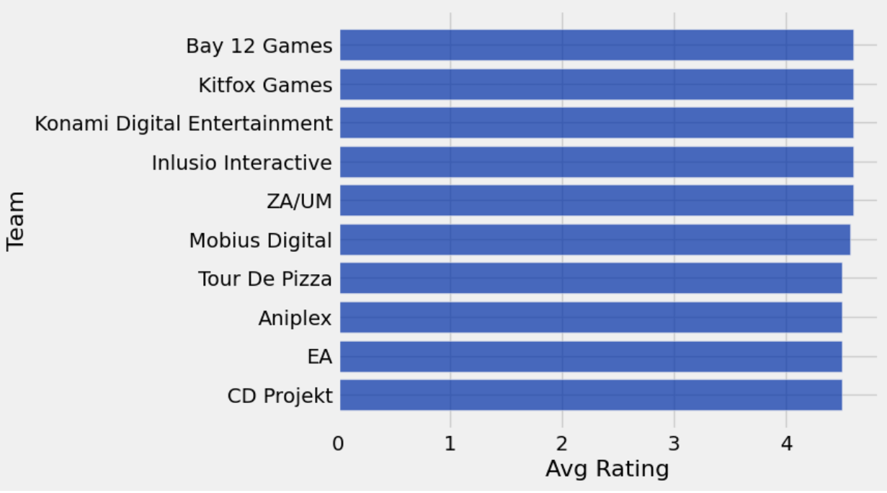
Nareh’s Mini Updates
2
Show: The top 10 development teams by average rating all score between roughly 4.4 and 4.6, with studios like Bay 12 Games, Kitfox Games, and Konami Digital Entertainment leading the industry. Notably, EA also appears in the top 10.
Tell: Many of these top-rated teams are smaller or indie studios rather than major AAA publishers, which suggests that bigger doesn't always mean better in game development. EA's presence is surprising given its reputation among gamers, but this reflects a small number of highly rated titles pulling their average up. This is a limitation worth noting since teams with only one or two games can easily land at the top.

Slide 27
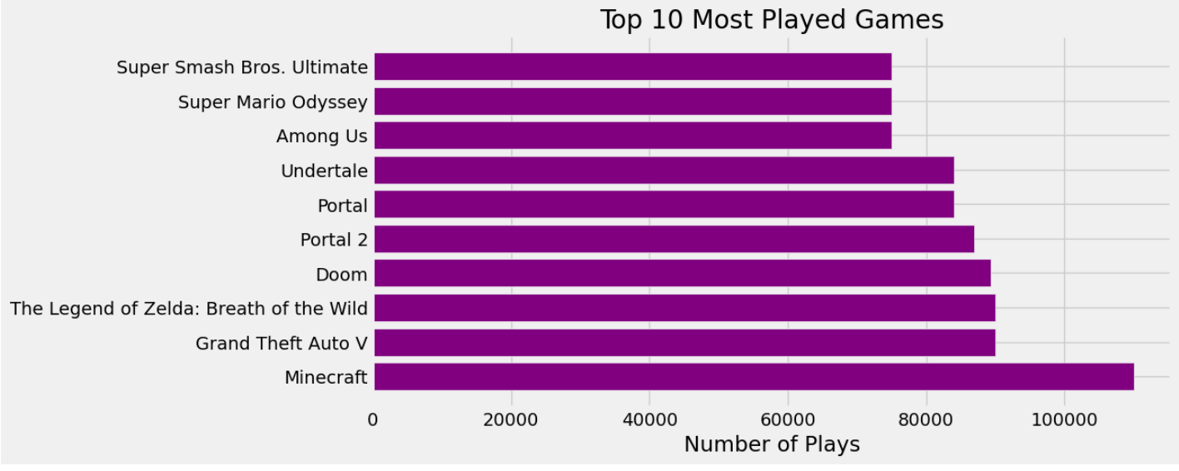
Fatimah’s Mini Updates
1
Top 10 Most Played Games
Show: Minecraft sits at the top with over 100,000 plays, noticeably ahead of every other game. Grand Theft Auto V and The Legend of Zelda: Breath of the Wild come in second and third with around 90,000 plays. The rest of the top 10 including Doom, Portal, Undertale, and Among Us are all pretty close to each other between 75,000 and 88,000 plays.
Tell: Minecraft being number one is not surprising but the gap between it and everything else is bigger than expected. It also shows that older games like GTA V and Zelda still dominate play counts, meaning popularity does not fade quickly for well loved games.

Slide 28
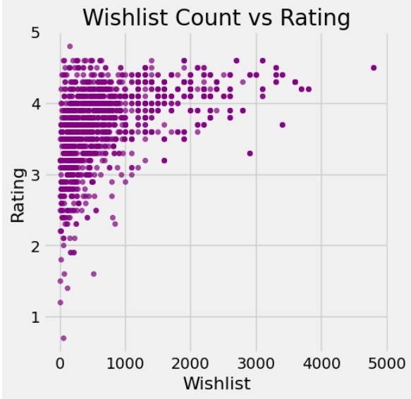
Fatimah’s Mini Updates
2
Wishlist Count vs Rating
Show: Most games have a wishlist count under 1,000 and ratings that range anywhere from 1 to 4.5. As wishlist count goes up, the ratings tend to stay above 3.5. There is one outlier sitting near 4,800 wishlists with a high rating around 4.5.
Tell: This graph suggests that games people actually want to play tend to live up to the hype. Low rated games barely show up on wishlists at all, which makes sense since word of mouth probably stops people from adding bad games. The one outlier way out to the right is interesting since it has way more wishlist activity than anything else in the dataset.

Slide 29
Progress Slide
Accomplished:Cleaned the dataset by removing TBD dates, converting K values to numbers, and parsing genre and team columns. Created two data insight plots: a scatter plot exploring plays vs. rating and a bar chart of top 10 development teams by average rating.
Plan for next week:Explore our remaining curious questions about genre trends over time and overhyped vs hidden gem games. Create 2-3 more data insight plots.
Obstacles:Some release dates had 'TBD' instead of actual dates which caused errors. Several numeric columns like Plays and Wishlist were stored as text with 'K' abbreviations that needed converting.
Resources: datascience library, story studio.
Contributions: Nareh; cleaned data set, contributed 2 data insights.
Fatimah; contributed 2 data insights.

Slide 30

Update #1
01
(Data Profile, Curious Questions, target audience, && communication goals);

Slide 31
Data Profile
Column Name | Has missing value? | Data Type(Discrete or numeric or free text) | Useful? | Need cleaning or processing?
Title | No | Text | Yes | No
Release Date | No | Text | Yes | Yes, convert to proper date
Team | Yes (1) | Text | Yes | Yes, it's stored as a string that looks like a list
Rating | Yes (13) | Numeric | Yes | Yes, handle missing value
Times Listed | No | Text | Yes | Yes, convert k to a value
Number of Reviews | No | Text | Yes | Yes, same issue
Genres | No | Text | Yes | Yes, stored as string

Slide 32
Data Profile
Column Name | Has missing value? | Data Type(Discrete or numeric or free text) | Useful? | Need cleaning or processing?
Summary | Yes (1) | Text | Maybe | No
Reviews | No | Text | Maybe | No
Plays | No | Text | Yes | Yes, "K" conversion issue
Playing | No | Text | Yes | Yes, "K" conversion issue
Backlogs | No | Text | Yes | Yes, "K" conversion issue
Wishlist | No | text | Yes | Yes, "K" conversion issue
This dataset has 1,512 rows and 14 columns

Slide 33
Curious Questions
What makes a game highly rated? Do certain genres, team sizes, or release years tend to produce a higher rating?
How has the gaming landscape changed over time? Are certain genres becoming more or less popular over the years? Are more games being released now than before?
What games are the most "overhyped"? Which games have tons of plays but low ratings, and which hidden gems have few plays but amazing ratings?
Which development teams consistently make the best games? Are there studios that make popular games every time, and what do they have in common?

Slide 34

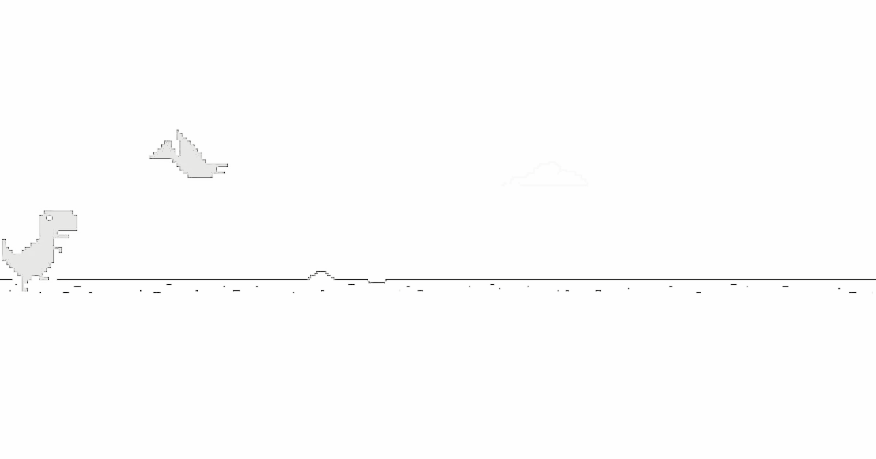
Audience and Communication Goals
Audience
Independent and mid sized gaming studios seeking to understand market trends or player preferences
Communication Goals
To provide data-driven insights into consumer preferences to enable developers to make more informed decisions during the game design process.

Slide 35

Update #6
01
(Final Weekly Mini Update);

Slide 36
Nareh’s Mini Update
1

Slide 37
Fatimah’s Mini Update
1

Slide 38
Progress Slide
Accomplished:
Plan for next week:
Obstacles:
Resources:
Contributions:

